Slide 1

Presentation Materials Created by Mimetics Inc.
Free use by anyone for non-commercial purposes
Copyrights, Trademarks and other Registered Marks the Property of their Owners

Slide 2
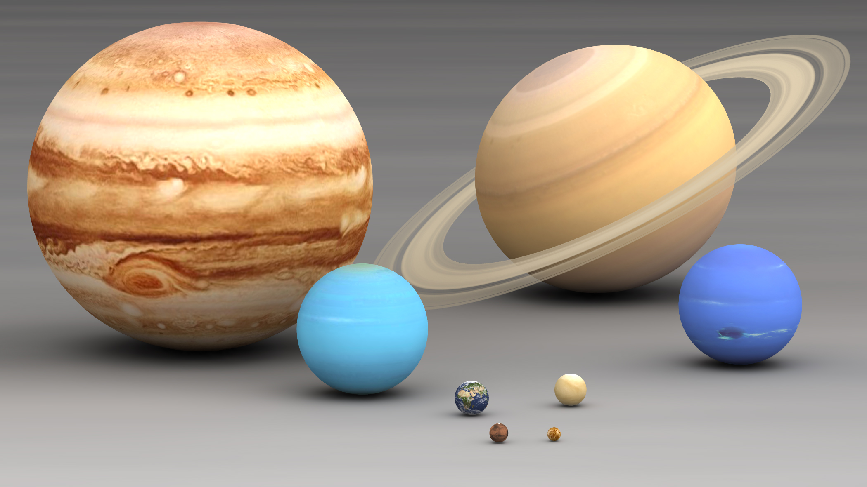
Grade 8 Systems - Class 4
Variables and Comparisons
Notes:
We want to introduce the Jade Robot and it’s Tools in more detail along with our action plans for it.
It’s interesting, but it’s easy to criticize something when it’s done (especially when you have experience) – a *LOT* more difficult getting it right from the start. Also, preparing this presentation was a great way to review and think about what we should be doing.

Slide 3

Grade 8 Systems - Class 4
Variables and Comparisons
Notes:
We want to introduce the Jade Robot and it’s Tools in more detail along with our action plans for it.
It’s interesting, but it’s easy to criticize something when it’s done (especially when you have experience) – a *LOT* more difficult getting it right from the start. Also, preparing this presentation was a great way to review and think about what we should be doing.

Slide 4
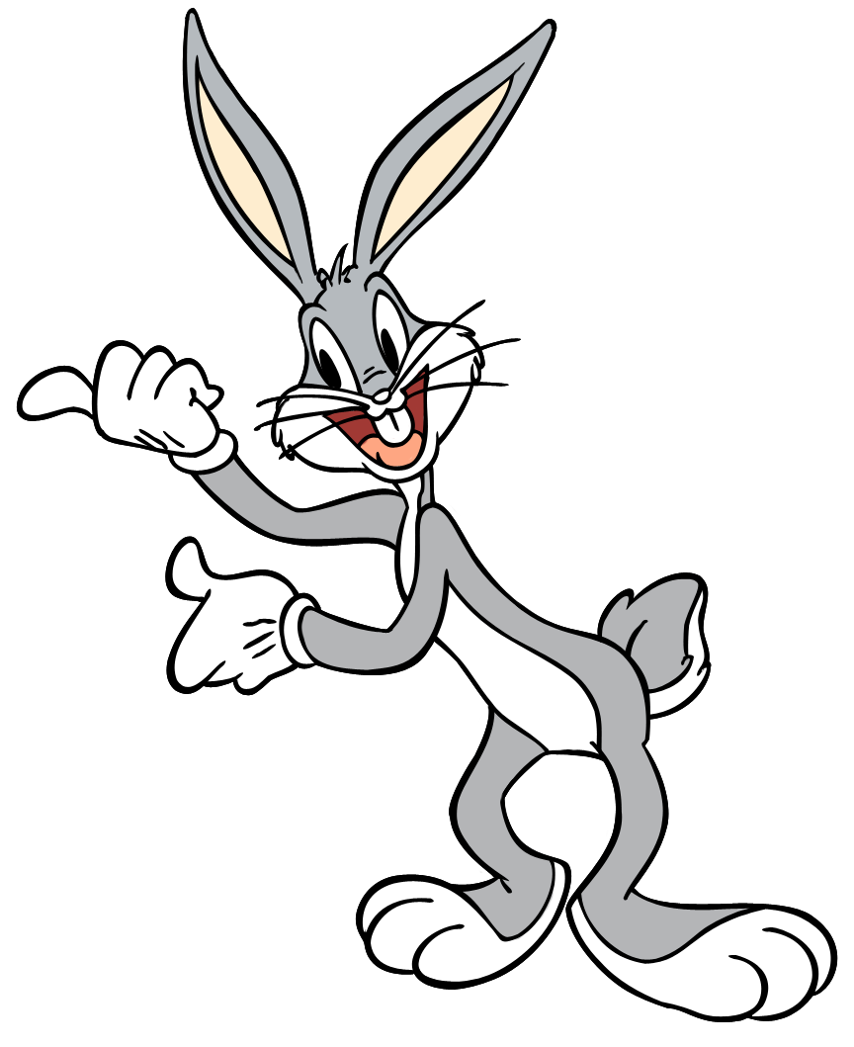
Recap
What is Programming?
What is a Loop?
What are the Outputs on the Jade Robot?
What are the Mathematical Operations?
What can you use Buttons for?
Notes:
Can Demo Jade Scratch if people are interested. In doing this product I’ve had a few interesting discoveries – one was going with a simpler programming language actually has a *LOT* of value for an expert like myself.

Slide 5
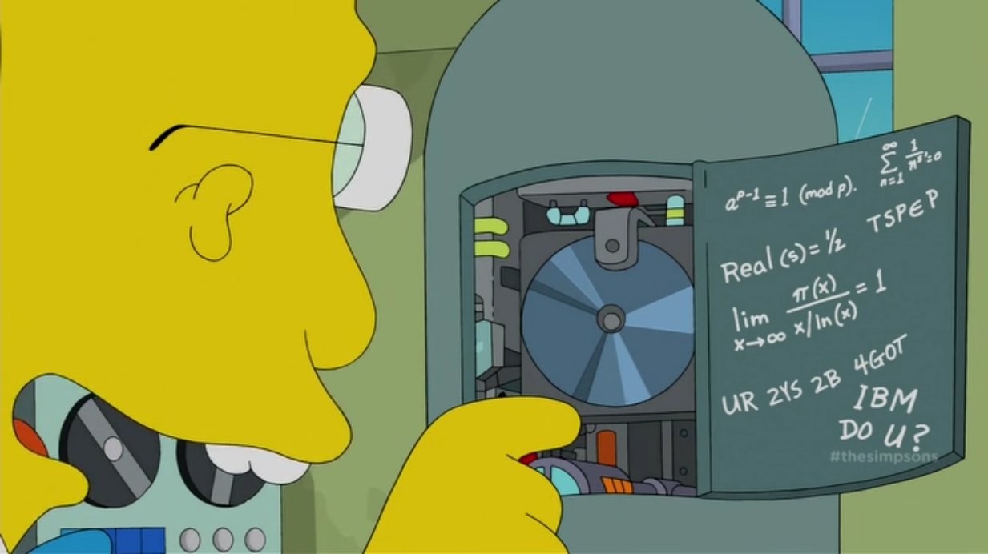
Variables
Notes:
We clone a community project into “My Projects” so we can make changes to it without affecting all the “Community Projects”

Slide 6
4 = A + 1
B = C + D
Notes:
Can Demo Jade Scratch if people are interested. In doing this product I’ve had a few interesting discoveries – one was going with a simpler programming language actually has a *LOT* of value for an expert like myself.

Slide 7

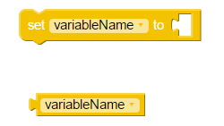
Things to Know About Scratch Variables
Initialize/Save Data in “variable”
Get Saved Data in “variable”
Variable Stores Integer Data
Variable Name Starts with “_”, “a”-”z”, “A”-”Z”
Notes:
Can Demo Jade Scratch if people are interested. In doing this product I’ve had a few interesting discoveries – one was going with a simpler programming language actually has a *LOT* of value for an expert like myself.

Slide 8
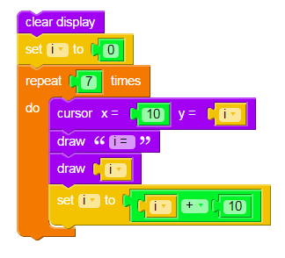
“Var1” Program
“Initialize” Variable
Get Variable
Update Variable
Notes:
Can Demo Jade Scratch if people are interested. In doing this product I’ve had a few interesting discoveries – one was going with a simpler programming language actually has a *LOT* of value for an expert like myself.

Slide 9
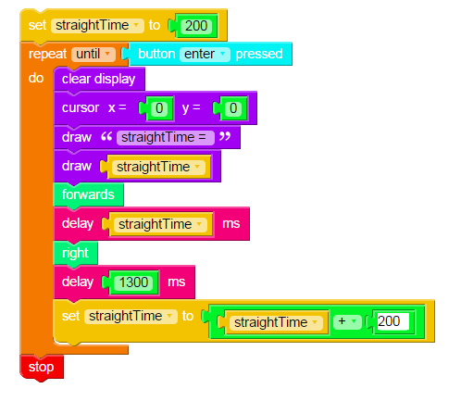
“Var2” Program
What does this program do?
When does it end?
Notes:
Can Demo Jade Scratch if people are interested. In doing this product I’ve had a few interesting discoveries – one was going with a simpler programming language actually has a *LOT* of value for an expert like myself.

Slide 10
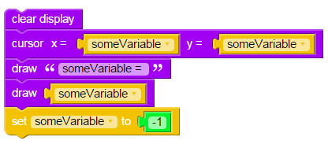
“Var3” Program
What is the problem with this program?
Notes:
Can Demo Jade Scratch if people are interested. In doing this product I’ve had a few interesting discoveries – one was going with a simpler programming language actually has a *LOT* of value for an expert like myself.

Slide 11
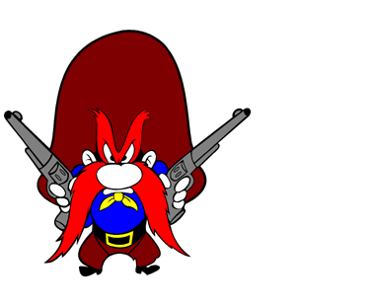
Initializing Variables
MUST Have a
Before:
Notes:
Can Demo Jade Scratch if people are interested. In doing this product I’ve had a few interesting discoveries – one was going with a simpler programming language actually has a *LOT* of value for an expert like myself.

Slide 12
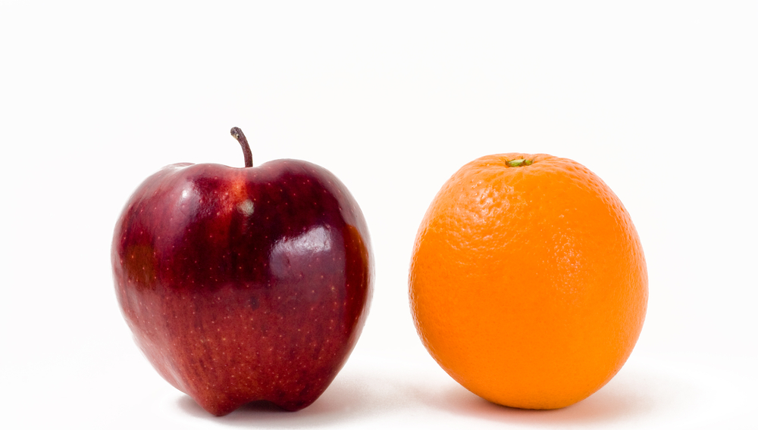
Comparisons
Notes:
We clone a community project into “My Projects” so we can make changes to it without affecting all the “Community Projects”

Slide 13
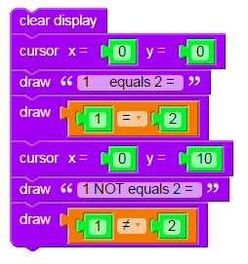
Equals & Not Equals
What is “True”?
What is “False”?
Notes:
Can Demo Jade Scratch if people are interested. In doing this product I’ve had a few interesting discoveries – one was going with a simpler programming language actually has a *LOT* of value for an expert like myself.

Slide 14
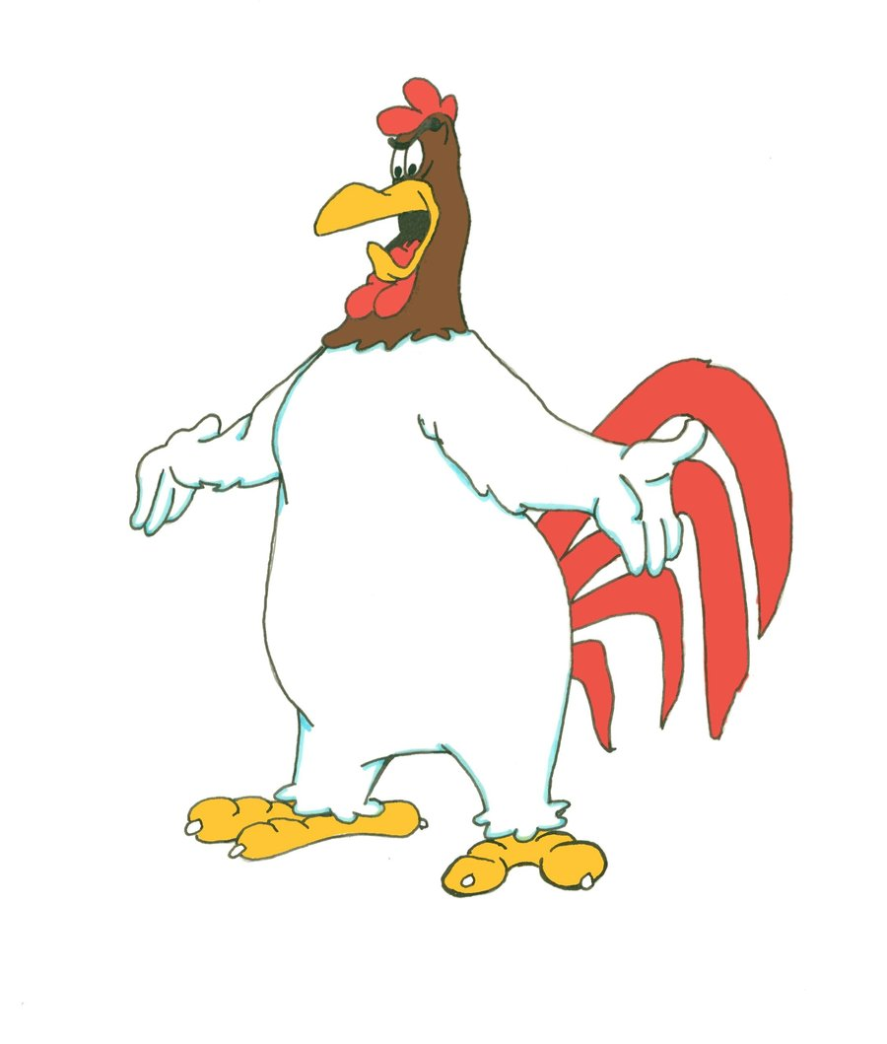
True & False
“True” is an Non-Zero Integer
“False” is Zero
Notes:
Can Demo Jade Scratch if people are interested. In doing this product I’ve had a few interesting discoveries – one was going with a simpler programming language actually has a *LOT* of value for an expert like myself.

Slide 15
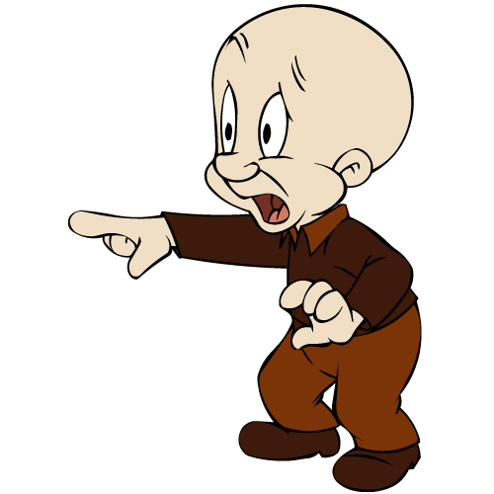
Comparison Operators
“Equals” is A = B
“Not Equals” is A ≠ B
“Less Than” is A < B
“Less Than or Equals” is A ≤ B
“Greater Than” is A > B
“Greater Than or Equals” is A ≥ B
Notes:
Can Demo Jade Scratch if people are interested. In doing this product I’ve had a few interesting discoveries – one was going with a simpler programming language actually has a *LOT* of value for an expert like myself.

Slide 16

What are Comparisons Used For?
Notes:
Can Demo Jade Scratch if people are interested. In doing this product I’ve had a few interesting discoveries – one was going with a simpler programming language actually has a *LOT* of value for an expert like myself.

Slide 17
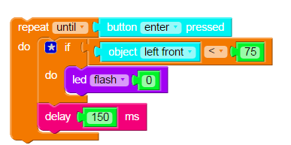
Decide Whether or Not to Do Something
Notes:
Can Demo Jade Scratch if people are interested. In doing this product I’ve had a few interesting discoveries – one was going with a simpler programming language actually has a *LOT* of value for an expert like myself.

Slide 18
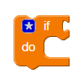
“if” Statement
If Value ≠ 0
Do This
Notes:
Can Demo Jade Scratch if people are interested. In doing this product I’ve had a few interesting discoveries – one was going with a simpler programming language actually has a *LOT* of value for an expert like myself.

Slide 19
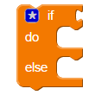
“if-else” Statement
If Value ≠ 0
Do This
Else, Do This
Notes:
Can Demo Jade Scratch if people are interested. In doing this product I’ve had a few interesting discoveries – one was going with a simpler programming language actually has a *LOT* of value for an expert like myself.

Slide 20
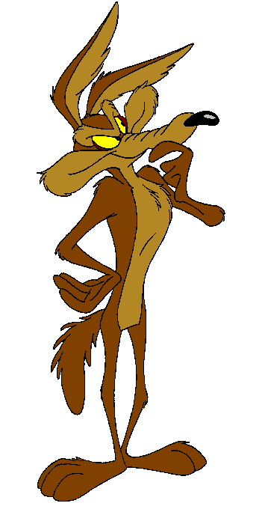
Challenge
Create a program that:
Repeat Until Red “Enter” Button Pressed
if LeftObject Sensor < 75
Turn Right for 200ms
else
Go Forwards for 200ms
Notes:
Can Demo Jade Scratch if people are interested. In doing this product I’ve had a few interesting discoveries – one was going with a simpler programming language actually has a *LOT* of value for an expert like myself.

